Slide 1
COVID-19 Topic modeling with LDA
Amri Muhaimin (穆海敏) - 0852627
Dwilaksana Abdullah Rasyid (艾柏朗) - 0852628

Slide 2
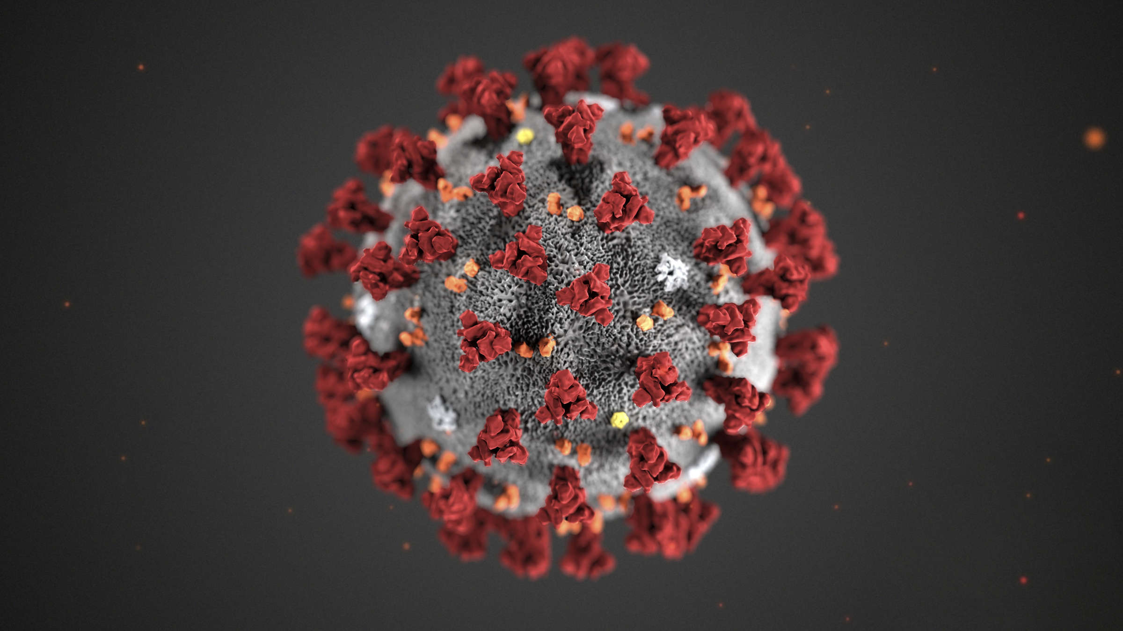
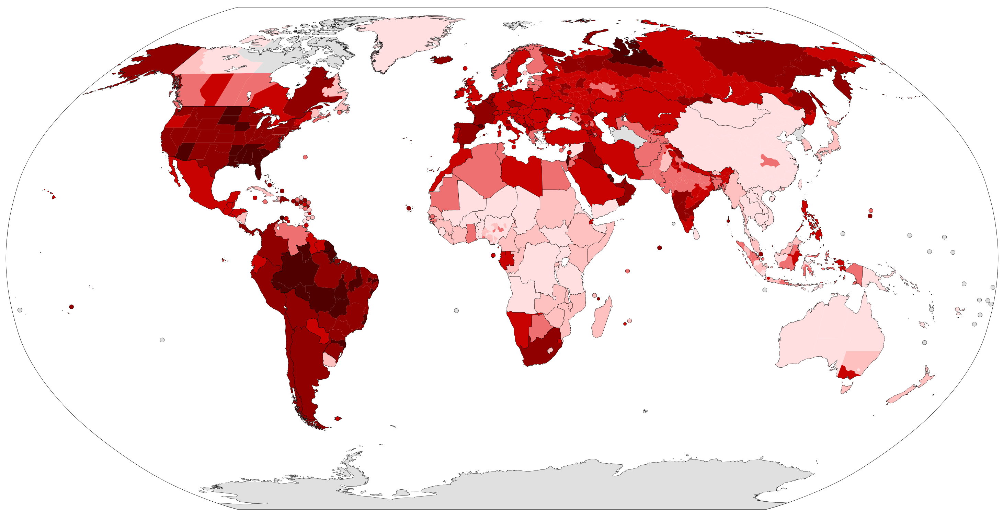


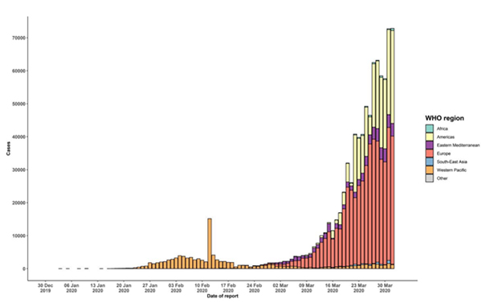

Background
Dec, 2019
Researcher or scientist starting their research, and then publish it to the portal such as sciencedirect and etc.
rise significantly

Slide 3

Recent research
Ding & Chen (2014)
Dynamic topic detection and tracking: a comparison of HDP, C-word, and cocitation methods
Li & Lei (2017)
A bibliometric analysis of topic modelling studies (2000-2017)
Kim & Kang (2019)
Analysis of research topics among library, archives, and museums using topic modeling

Slide 4
Purpose study
Topic modeling using LDA about coronavirus, the data that used is from sciencedirect (abstract)

Slide 5

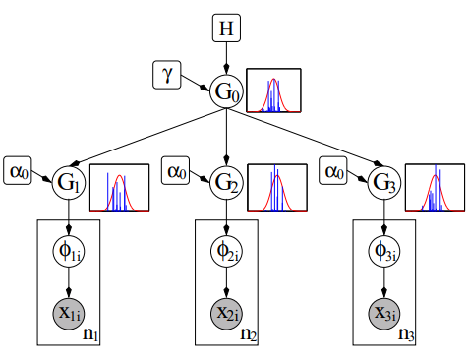
Materials and methods
Text mining
Case folding
Tokenizing
Stemming
Stopwords
Hierarichal dirichlet process (HDP)

Slide 6
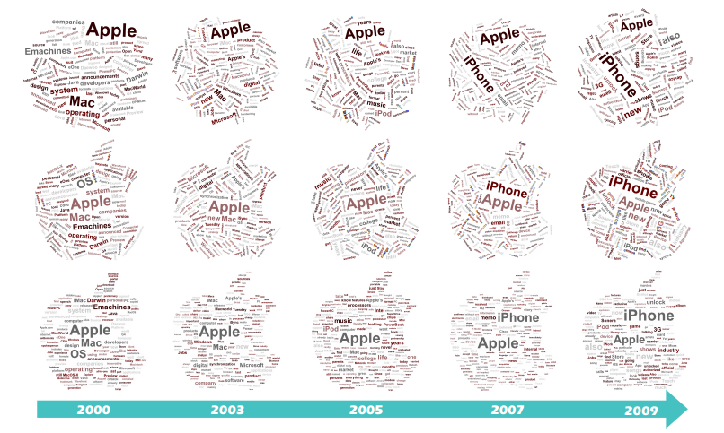
Materials and methods
Latent dirichlet allocation
Wordcloud

Slide 7


Data
Abstract
Keyword
Paper that contain Abstract, with citescore => 1
“COVID-19”
“2019-nCoV”
“SARS-nCOV-2”
“SARS-COV-2”
Tools

Slide 8
Topic evaluation
UCI
UMass
Coherence score
(Mimno, Wallach, Talley, Leenders, & McCallum, 2011)

Slide 9
Analysis Step
Scraping using scrapy
Based on keyword
Pre-procesing text
Case folding
Tokenizing
Stemming
stopwords
Topic modeling
HDP
LDA
Wordcloud visualization
Conclusion

Slide 10
Reference
Dragut, E., Fang, F., Sistla, P., Yu, C., & Meng, W. (2009). Stop Word and Related Problems in Web Interface Integration. Proceedings of the VLDB Endowment, 24-28.
Feldman, R., & Sanger, J. (2007). The Text Mining Handbook. New York: Cambridge University Press.
Fithriasari, K., Mayasari, R. W., Iriawan, N., & Winahju, W. S. (2020). Surabaya Government Performance Evaluation using Tweet Analysis. MATEMATIKA: MJIAM, 31-42.
Kim, H., & Kang, B. (2019). Analysis of Research Topics among Library, Archives and Museums using Topic Modeling . Journal of Korean Library and Information Science Society, 339-358.
Bee, S., & Gupta, S. (2016). a Brief Survey of Various Approaches for Feature of Text Mining. International Journal of Research in Computer Applications and Robotics, 1-8.
Chi, M.-T., Lin, S.-S., Lin, C.-H., & Lee, T.-Y. (2011). Morphable Word Clouds for Time-varying Text Data Visualization. IEEE Transactions on Visualization and Computer Graphics.
Ding, W., & Chen, C. (2014). Dynamic Topic Detection and Tracking: A Comparison of HDP, C-Word, and Cocitation Methods. JOURNAL OF THE ASSOCIATION FOR INFORMATION SCIENCE AND TECHNOLOGY, 2084-2097.
Lestari, N. M., Putra, I. K., & Cahyawan, A. K. (2013). Personality Types Classification for Indonesian Text in Partners Searching Website Using Naïve Bayes Methods. IJCSI International Journal of Computer Science Issues.
Li, X., & Lei, L. (2019). A bibliometric analysis of topic modelling studies (2000–2017). JIS (Journal of Information Science), 1-15.
Luo, Y., & Shi, H. (2019). Using lda2vec Topic Modeling to Identify Latent Topics in Aviation Safety Reports . ICIS (International Conference on Information Systems), 518-523.

Slide 11
Reference
Mimno, D., Wallach, H., Talley, E., Leenders, M., & McCallum, A. (2011). Optimizing Semantic Coherence in Topic Models. Proceedings of the 2011 Conference on Empirical Methods in Natural Language Processing, 262-272.
Moody, C. (2016). MixingDirichletTopicModelsandWordEmbeddingstoMakelda2vec. arXiv preprint.
Newman, D., Noh, Y., Talley, E., Karimi, S., & Baldwin, T. (2010). Evaluating Topic Models for Digital Libraries. JCDL’10, 215-224.
Nikolenko, S. I., Koltcov, S., & Koltsova, O. (2015). Topic modelling for qualitative studies. Journal of Information Science, 1-15.
Park , J., & Oh, H.-J. (2017). Comparison of Topic Modeling Methods for Analyzing Research Trends of Archives Management in Korea: focused on LDA and HDP. Journal of Korean Library and Information Science Society, 235-258.
Pedoman Pencegahan Pengendalian Coronavirus Disease (COVID-19). (2020). Jakarta: Kementerian Kesehatan RI, Direktorat Jendral PEncegahan dan Pengendalian PEnyakit (P2P).
Stevens, K., Kegelmeyer, P., Andrzejewski, D., & Buttler, D. (2012). Exploring Topic Coherence over many models and many topics. Association for Computational Linguistics, 952-961.
Teh, Y. W., Jordan, M., Beal, M. J., & Blei, D. M. (2005). Sharing Clusters Among Related Groups: Hierarchical Dirichlet Processes. In Advances in neural information processing systems, 1385-1392.
Vijayarani, S., & Janani, S. (2016). Text Mining: Open Source Tokenization Tools - An Analysis. Advanced Computational Intelligence: An International Journal (ACII).
Wu, Y., Provan, T., Wei, F., Liu, S., & Ma, K.-L. (2011). Semantic-Preserving Word Clouds by Seam Carving. The Eurographics Association and Blackwell Publishing Ltd, 741-750.

